Slide 1
Block Ciphers and Modes of Operation
CS 161 Fall 2022 - Lecture 6

Slide 2
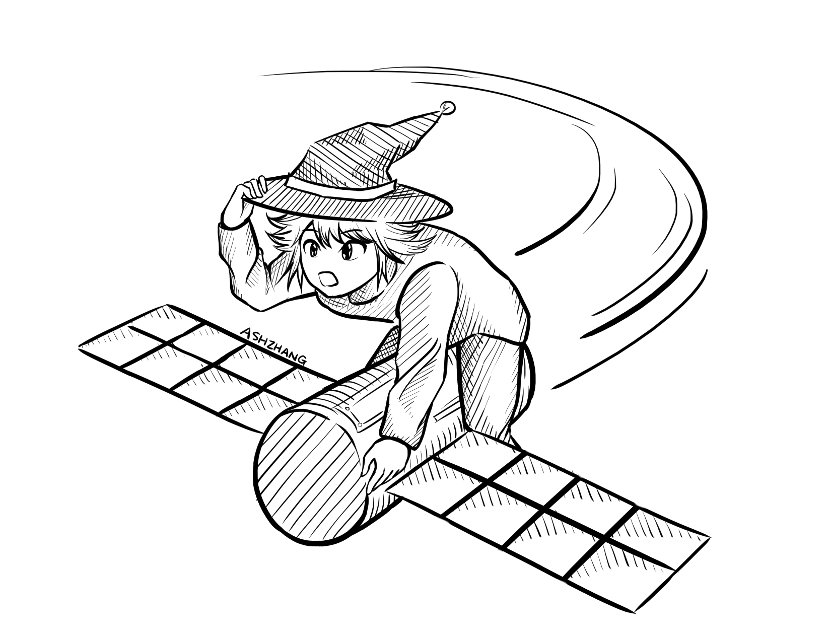
Announcements
Project 1 has been released.
The checkpoint (Q1–Q4) is due Friday, September 16th at 11:59 PM PT.
The full project (Q1–Q7 plus write-up) is due Friday, September 30th at 11:59 PM PT.
Homework 2 is due Friday, September 23rd at 11:59 PM PT.
Project 1 Party on Thursday, September 15th, 3:00 to 5:00 PM PT in the Wozniak Lounge (Soda 430).
The extended time discussion with Abhi and Akshit has been finalized for Monday from 3:00 to 4:30 PM PT in Soda 380.
Notes:
Want to submit an announcements doodle? Email evanbot@berkeley.edu or post on Piazza!

Slide 3
Summary
What’s cryptography?
Communicating securely over insecure channels
You should never write your own crypto! Use existing libraries instead.
Definitions
Alice and Bob want to send messages over an insecure channel. Eve can read anything sent over the insecure channel. Mallory can read or modify anything sent over the insecure channel.
We want to ensure confidentiality (adversary can’t read message), integrity (adversary can’t modify message), and authenticity (prove message came from sender)
Crypto uses secret keys. Kerckhoff’s principle says to assume the attacker knows the entire system, except the secret keys.
There are several different threat models. We’ll focus on the chosen plaintext attack, where Eve tricks Alice into encrypting some messages.

Slide 4
Summary
IND-CPA security
Even if Eve can trick Alice into encrypting some messages of Eve’s choosing, given the encryption of either M0 or M1, Eve cannot distinguish which message was sent with probability greater than 1/2.
We can use the IND-CPA game to test for IND-CPA security
Edge cases: IND-CPA secure schemes can leak length. Eve is limited to polynomial-time algorithms, and must have a non-negligible advantage to win.
One-time pads
Symmetric encryption scheme: Alice and Bob share a secret key.
Encryption and decryption: Bitwise XOR with the key.
No information leakage if the key is never reused.
Information leaks if the key is reused.
Impractical for real-world usage, unless you’re a spy.

Slide 5
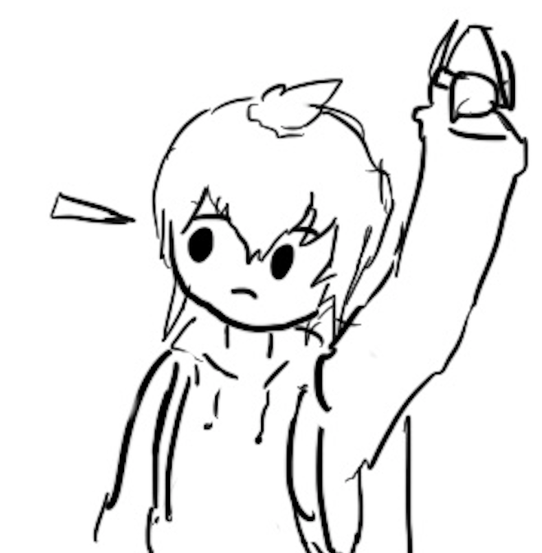
Block Ciphers
Textbook Chapter 6.4 & 6.5

Slide 6
Cryptography Roadmap
 | Symmetric-key | Asymmetric-key
Confidentiality | One-time pads Block ciphers with chaining modes (e.g. AES-CBC) Stream ciphers | RSA encryption ElGamal encryption
Integrity, Authentication | MACs (e.g. HMAC) | Digital signatures (e.g. RSA signatures)
Hash functions
Pseudorandom number generators
Public key exchange (e.g. Diffie-Hellman)
Key management (certificates)
Password management

Slide 7
Block Ciphers: Definition
plaintext
Block cipher: An encryption/decryption algorithm that encrypts a fixed-sized block of bits
EK(M) → C: Encryption
Inputs: k-bit key K and an n-bit plaintext M
Output: An n-bit ciphertext C
Sometimes written as: {0, 1}^{k} × {0, 1}^{n} → {0, 1}^{n}
DK(C) → M: Decryption
Inputs: a k-bit key, and an n-bit ciphertext C
Output: An n-bit plaintext
Sometimes written as: {0, 1}^{k} × {0, 1}^{n} → {0, 1}^{n}
The inverse of the encryption function
Properties
Correctness: EK is a permutation, DK is its inverse
Efficiency: Encryption/decryption should be fast
Security: E behaves like a random permutation
n bits
K
k bits
E
n bits
ciphertext
ciphertext
n bits
K
k bits
D
n bits
plaintext

Slide 8
Block Ciphers: Correctness
EK(M) must be a permutation (bijective function) on n-bit strings
Each input must correspond to exactly one unique output
Intuition
Suppose EK(M) is not bijective
Then two inputs might correspond to the same output: E(K, x1) = E(K, x2) = y
Given ciphertext y, you can’t uniquely decrypt. D(K, y) = x1? D(K, y) = x2?
00
01
10
11
00
01
10
11
00
01
10
11
00
01
10
11
Not bijective: Two inputs encrypt to the same output
Bijective: Each input maps to exactly one unique output

Slide 9
Block Ciphers: Security
A secure block cipher behaves like a randomly chosen permutation permutation from the set of all permutations on n-bit strings
A random permutation: Each n-bit input is mapped to one randomly-chosen n-bit output
Defined by a distinguishing game
Eve gets two boxes: One is a randomly chosen permutation, and one is EK with a randomly chosen key K
Eve should not be able to tell which is which with probability > 1/2
00
01
10
11
00
01
10
11
00
01
10
11
00
01
10
11
One of these is EK with a randomly chosen K, and the other one is a randomly chosen permutation. Eve can’t distinguish them.

Slide 10
Block ciphers: Brute-force attacks?
How hard is it to run a brute-force attack on a 128-bit key?
We have to try 2¹²⁸ possibilities. How big is 2¹²⁸?
Handy approximation: 2¹⁰ ≈ 10³
2¹²⁸ = 2^{10*12.8} ≈ (10³)^{12.8} ≈ (10³)¹³ = 10³⁹
Suppose we have massive hardware that can try 10⁹ (1 billion) keys in 1 nanosecond (a billionth of a second). That’s 10¹⁸ keys per second
We’ll need 10³⁹ / 10¹⁸ = 10²¹ seconds. How long is that?
One year ≈ 3×10⁷ seconds
10²¹ seconds / 3×10⁷ ≈ 3×10¹³ years ≈ 30 trillion years
Takeaway: Brute-forcing a 128-bit key takes astronomically long. Don’t even try.

Slide 11
Block ciphers: Brute-force attacks?
How hard is it to run a brute-force attack on a 256-bit key in the same time?
We need 10⁵² of the brute-force devices from before
If each brute-force device from before is 1 cubic millimeter, this would take 10⁴³ cubic meters of space
That’s the volume of 7×10¹⁵ suns!
For reference, the Milky Way galaxy has just 10¹¹ stars
Takeaway: Brute-force attacks on modern block ciphers are not possible, assuming the key is random and secret
128-bit key? Definitely not happening.
256-bit key? Lol no.

Slide 12
Block Ciphers: Efficiency
Encryption and decryption should be computable in microseconds
Formally: KeyGen(), Enc(), and Dec(), should not take exponential time
Block cipher algorithms typically use operations like XOR, bit-shifting, and small table lookups
Very fast on modern processors
Modern CPUs provide dedicated hardware support for block ciphers
Notes:
TODO This should be E and D, not KeyGen, Enc, and Dec

Slide 13
DES (Data Encryption Standard)
Designed in late 1970s
Block size 64 bits (n = 64)
Key size 56 bits (k = 56)
NSA influenced two facets of its design
Altered some subtle internal workings in a mysterious way
Reduced key size from 64 bits to 56 bits
Made brute force attacks feasible for an attacker with massive computational resources (by 1970s standards)
The algorithm remains essentially unbroken 40 years later
The NSA’s tweaking hardened it against an attack publicly revealed a decade later
However, modern computer speeds make it completely unsafe due to small key size
~6.4 × 10¹⁶, say 10¹⁰ tries per second on my single desktop computer's Nvidia graphics card: Takes ~6.4 × 10⁶ seconds or ~70 days

Slide 14
AES (Advanced Encryption Standard)
1997–2000: NIST (National Institute of Standards and Technology) in the US held a competition to pick a new block cipher standard
One of the finalists, Twofish, was designed by Berkeley professor and occasional CS 161 instructor David Wagner!
Out of the 5 finalists:
Rijndael, Twofish, and Serpent had really good performance
RC6 had okay performance
Mars had ugly performance
On any given computing platform, Rijndael was never the fastest
But on every computing platform, Rijndael was always the second-fastest
Twofish and Serpent each had at least one compute platform they were bad at
Rijndael was selected as the new block cipher standard

Slide 15
AES (Advanced Encryption Standard)
Key size 128, 192, or 256 bits (k = 128, 192, or 256)
Actual cipher names are AES-128, AES-192, and AES-256
Paranoid people like the NSA use AES-256 keys, but AES-128 is just fine in practice
Block size 128 bits (n = 128)
Note: The block size is still always 128 bits, regardless of key size
You don’t need to know how AES works, but you do need to know its parameters
here’s a comic

Slide 16
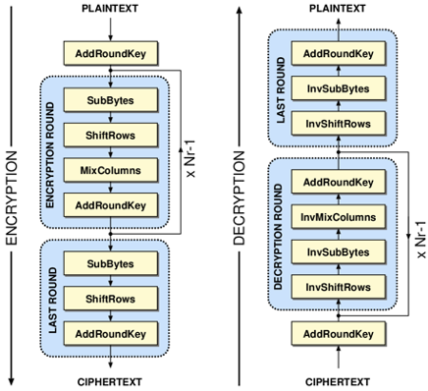
AES Algorithm
Different key sizes use different numbers of rounds
10 rounds for 128-bit keys
12 rounds for 192-bit keys
14 rounds for 256-bit keys
Each round uses its own “round key” derived from the cipher key
Each round:
SubBytes()
ShiftRows()
MixColumns() (if not last round)
AddRoundKey()
Notes:
AES slides, credit Kevin Orr

Slide 17
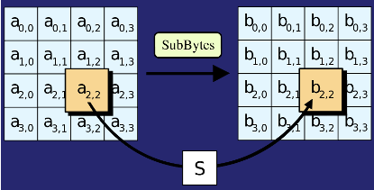
AES Algorithm: SubBytes()
Replace each byte in the block with another byte using an 8-bit substitution box

Slide 18
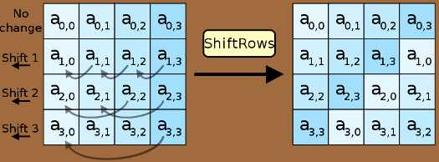
AES Algorithm: ShiftRows()
Cyclically shifts the bytes in each row by a certain offset
The number of places each byte is shifted differs for each row

Slide 19
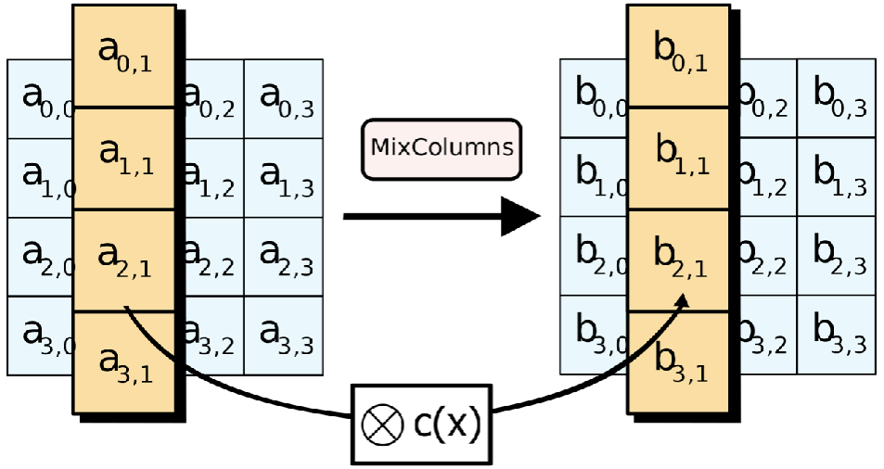
AES Algorithm: MixColumns()
Treats the 16-byte block as a 4 × 4 matrix and multiply it by by another matrix

Slide 20
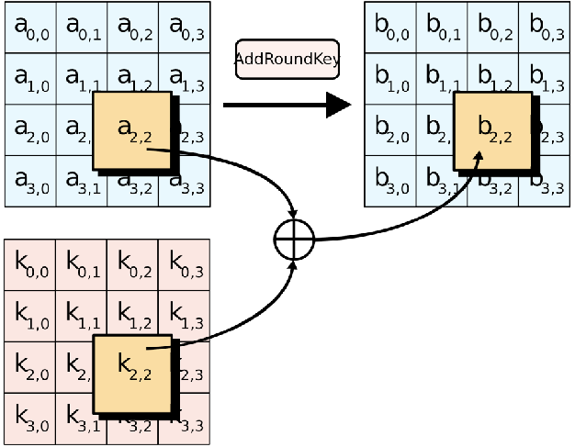
AES Algorithm: AddRoundKey()
XOR the 16-byte block with the 16-byte round key

Slide 21
AES (Advanced Encryption Standard)
There is no formal proof that AES is secure (indistinguishable from a random permutation)
However, in 20 years, nobody has been able to break it, so it is assumed to be secure
The NSA uses AES-256 for secrets they want to keep secure for the 40 years (even in the face of unknown breakthroughs in research)
Takeaway: AES is the modern standard block cipher algorithm
The standard key size (128 bits) is large enough to prevent brute-force attacks

Slide 22
Are Block Ciphers IND-CPA Secure?
Eve (adversary)
Alice (challenger)
Consider the following adversary:
Eve sends two different messages M0 and M1
Eve receives either EK(M0) or EK(M1)
Eve requests the encryption of M0 again
Strategy: If the encryption of M0 matches what she received, guess b = 0. Else, guess b = 1.
Eve can win the IND-CPA game with probability 1!
Block ciphers are not IND-CPA secure
M
(repeat)
Enc(K, M)
M0 and M1
pick b
Enc(K, Mb)
M
(repeat)
Enc(K, M)
Guess b = 0 or b = 1

Slide 23
Issues with Block Ciphers
Block ciphers are not IND-CPA secure, because they’re deterministic
A scheme is deterministic if the same input always produces the same output
No deterministic scheme can be IND-CPA secure because the adversary can always tell if the same message was encrypted twice
Block ciphers can only encrypt messages of a fixed size
For example, AES can only encrypt-decrypt 128-bit messages
What if we want to encrypt something longer than 128 bits?
To address these problems, we’ll add modes of operation that use block ciphers as a building block!
Notes:
Ask for any other issues students can think of after describing deterministic schemes

Slide 24
Summary: Block Ciphers
Encryption: input a k-bit key and n-bit plaintext, receive n-bit ciphertext
Decryption: input a k-bit key and n-bit ciphertext, receive n-bit plaintext
Correctness: when the key is fixed, EK(M) should be bijective
Security
Without the key, EK(m) is computationally indistinguishable from a random permutation
Brute-force attacks take astronomically long and are not possible
Efficiency: algorithms use XORs and bit-shifting (very fast)
Implementation: AES is the modern standard
Issues
Not IND-CPA secure because they’re deterministic
Can only encrypt n-bit messages

Slide 25
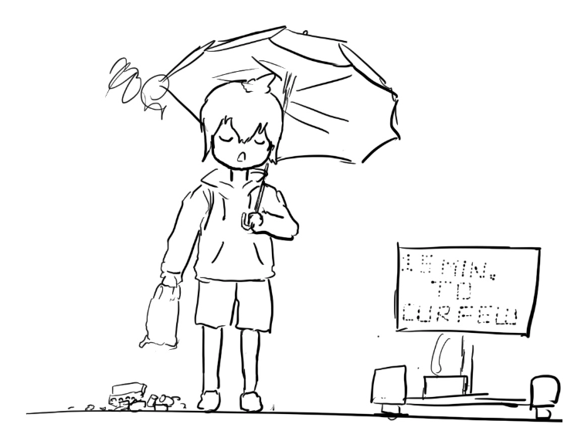
Block Cipher Modes of Operation
Textbook Chapter 6.6–6.9

Slide 26
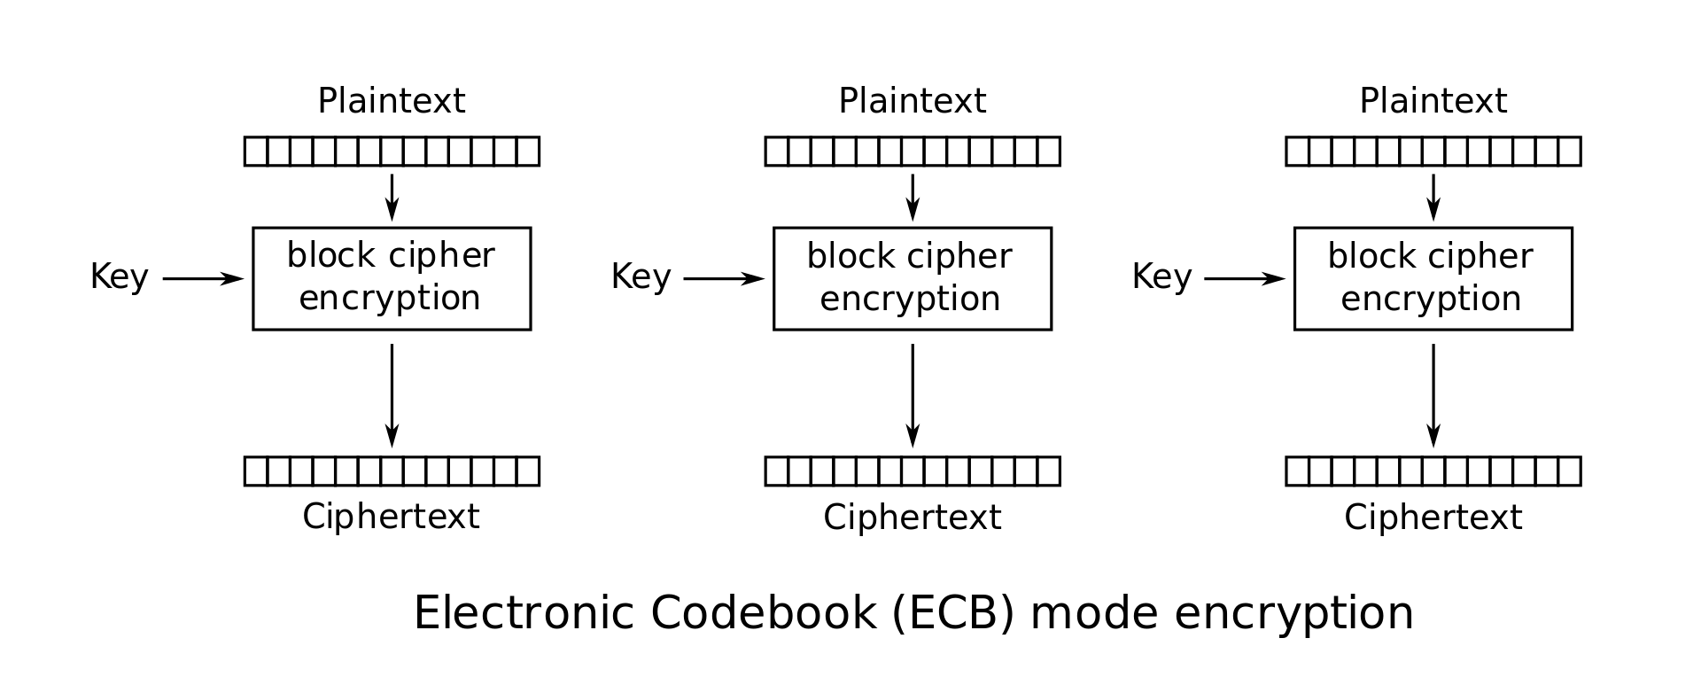
Scratchpad: Let’s design it together
Here’s an AES block. Remember that it can only encrypt 128-bit messages.
How can we use AES to encrypt a longer message (say, 256 bits?)

Slide 27
Scratchpad: Let’s design it together
Idea: Let’s use AES twice!
First 128 bits of message
Second 128 bits of message

Slide 28
Scratchpad: Let’s design it together
Note that we are using the same key twice. We want to avoid a situation like one-time pads where we need very long keys.

Slide 29
ECB Mode
We’ve just designed electronic code book (ECB) mode
Enc(K, M) = C1 || C2 || … || Cm
Assume m is the number of blocks of plaintext in M, each of size n
AES-ECB is not IND-CPA secure. Why?
Because ECB is deterministic

Slide 30

ECB Mode: Penguin
Original image

Slide 31

ECB Mode: Penguin
Encrypted with ECB

Slide 32
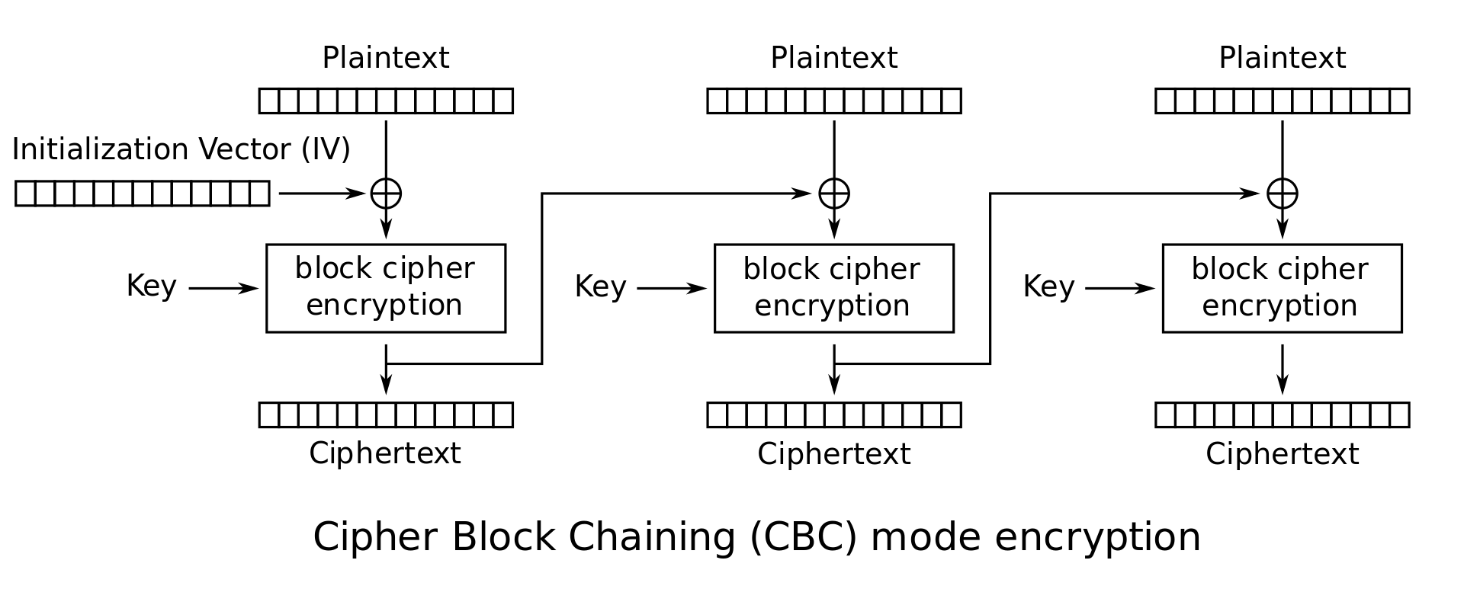
Scratchpad: Let’s design it together
Here’s ECB mode. It’s not IND-CPA secure because it’s deterministic.
Let’s fix that by adding some randomness.
Notes:
If students propose adding

Slide 33
Scratchpad: Let’s design it together
The Initialization Vector (IV) is different for every encryption. Now the first ciphertext block will be different for every encryption!
Okay, but the other blocks are still deterministic...
Notes:
If students propose adding

Slide 34
Scratchpad: Let’s design it together
Idea: The first ciphertext block was computed with some randomness. Let’s use it to add randomness to the second block.
Notes:
If students propose adding

Slide 35
Scratchpad: Let’s design it together
Now the second ciphertext block has some randomness in it. Let’s use it to add randomness to the third block.
Notes:
If students propose adding

Slide 36
CBC Mode
We’ve just designed cipher block chaining (CBC) mode
Ci = EK(Mi ⊕ Ci-1); C0 = IV
Enc(K, M):
Split M in m plaintext blocks P₁ … P_{m} each of size n
Choose a random IV
Compute and output (IV, C₁, …, C_{m}) as the overall ciphertext
How do we decrypt?
P₁
P₂
P_{m}

Slide 37
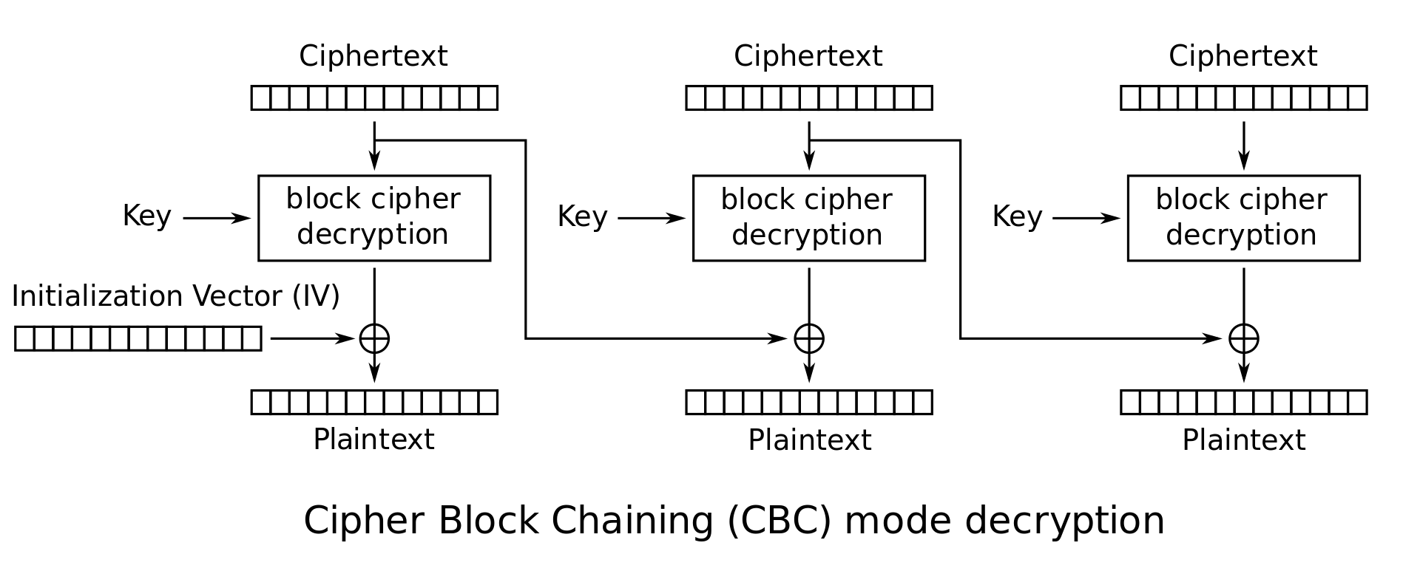
CBC Mode: Decryption
How do we decrypt CBC mode?
Parse ciphertext as (IV, C₁, …, C_{m})
Decrypt each ciphertext and then XOR with IV or previous ciphertext

Slide 38
CBC Mode: Decryption
Ci | = | EK(Mi ⊕ Ci-1) | Definition of encryption
DK(Ci) | = | DK(EK(Mi ⊕ Ci-1)) | Decrypting both sides
DK(Ci) | = | Mi ⊕ Ci-1 | Decryption and encryption cancel
DK(Ci) ⊕ Ci-1 | = | Mi ⊕ Ci-1 ⊕ Ci-1 | XOR both sides with Ci-1
DK(Ci) ⊕ Ci-1 | = | Mi | XOR property

Slide 39
CBC Mode: Efficiency & Parallelism
Can encryption be parallelized?
No, we have to wait for block i to finish before encrypting block i+1
Can decryption be parallelized?
Yes, decryption only requires ciphertext as input

Slide 40
CBC Mode: Padding
What if you want to encrypt a message that isn’t a multiple of the block size?
AES-CBC is only defined if the plaintext length is a multiple of the block size
Solution: Pad the message until it’s a multiple of the block size
Padding: Adding dummy bytes at the end of the message until it’s the proper length

Slide 41
CBC Mode: Padding
What padding scheme should we use?
Padding with 0’s?
Doesn’t work: What if our message already ends with 0’s?
Padding with 1’s?
Same problem
We need a scheme that can be unpadded without ambiguity
One scheme that works: Append a 1, then pad with 0’s
If plaintext is multiple of n, you still need to pad with an entire block
Another scheme: Pad with the number of padding bytes
So if you need 1 byte, pad with 01; if you need 3 bytes, pad with 03 03 03
If you need 0 padding bytes, pad an entire dummy block
This is called PKCS #7
Notes:
Ask: Ideas for unambiguous padding schemes

Slide 42
CBC Mode: Security
AES-CBC is IND-CPA secure. With what assumption?
The IV must be randomly generated and never reused
What happens if you reuse the IV?
The scheme becomes deterministic: No more IND-CPA security

Slide 43
CBC Mode: IV Reuse
Consider two three-block messages: P1P2P3 and P1P2P4
The first two blocks are the same for both messages, but the last block is different
What if we encrypt them with the same IV?
When the IV is reused, CBC mode reveals when two messages start with the same plaintext blocks, up to the first different plaintext block

Slide 44
CBC Mode is IND-CPA (when used correctly)
Enc(K, M):
Split M in m plaintext blocks P1 … Pm each of size n
Choose random IV, compute and output (IV, C1, …, Cm) as the overall ciphertext
Why IND-CPA?
If there exists an attacker that wins in the IND-CPA game, then there exists an attacker that breaks the block cipher security. Proof is out of scope.
P₁
P₂
P_{m}

Slide 45
CBC Mode: Penguin
Original image

Slide 46

CBC Mode: Penguin
Encrypted with CBC, with random IVs

Slide 47
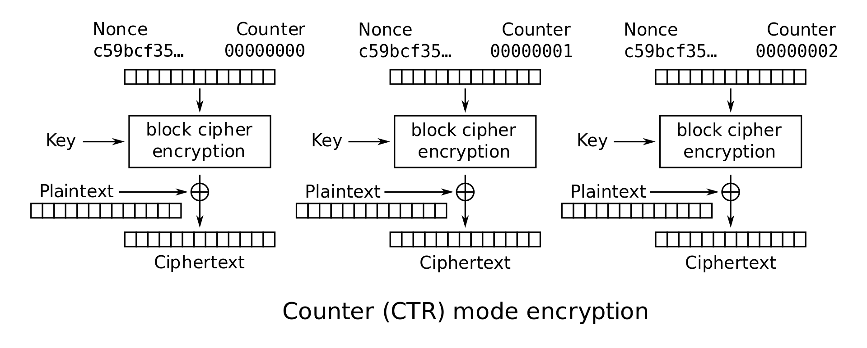
CTR Mode Scratchpad: Let’s design it together
One-time pads are secure if we never reuse the key.
Key

Slide 48
CTR Mode Scratchpad: Let’s design it together
If the attacker doesn’t know the key, the block cipher output looks random.
New idea: Can we use block ciphers to simulate a one-time pad?

Slide 49
CTR Mode Scratchpad: Let’s design it together
If the attacker doesn’t know the key, all of these outputs look random.

Slide 50
CTR Mode Scratchpad: Let’s design it together
Idea: Use this random-looking output as a one-time pad!
Remember one-time pads: XOR the pad with plaintext to get ciphertext

Slide 51
CTR Mode Scratchpad: Let’s design it together
What do we use as input to the block cipher?

Slide 52
CTR Mode Scratchpad: Let’s design it together
IND-CPA schemes need randomness, so let’s put a random nonce here!

Slide 53
CTR Mode Scratchpad: Let’s design it together
The counter increments per block to ensure each block cipher output is different.

Slide 54
CTR (Counter) Mode
Note: the random value is named the nonce here, but the idea is the same as the IV in CBC mode
Overall ciphertext is (Nonce, C₁, …, C_{m})
C₁
C_{m}

Slide 55
CTR Mode
Enc(K, M):
Split M in plaintext blocks P₁...P_{m} (each of block size n)
Choose random nonce
Compute and output (Nonce, C₁, …, C_{m})
How do you decrypt?
C₁
C_{m}

Slide 56
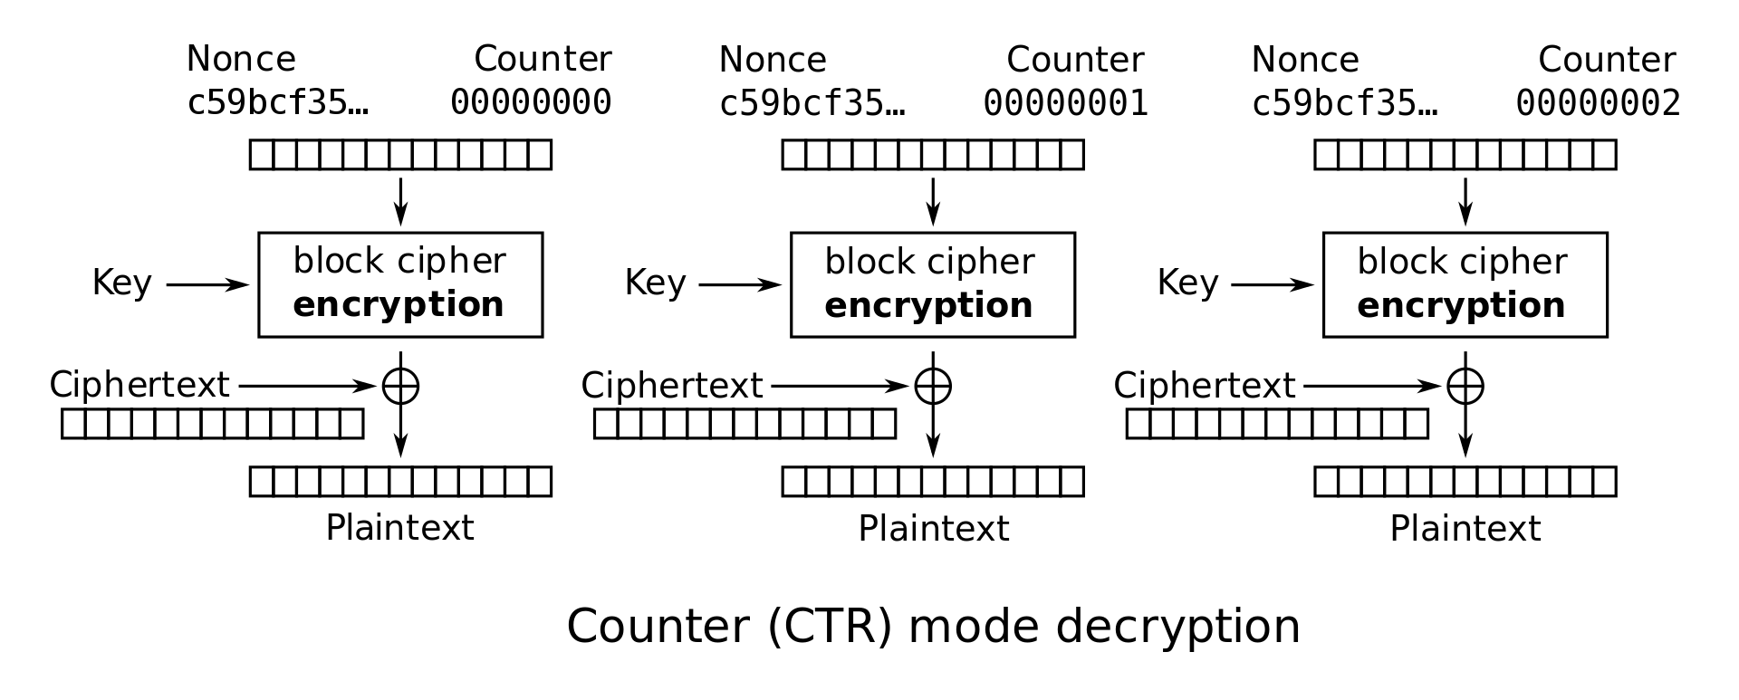
CTR Mode: Decryption
Recall one-time pad: XOR with ciphertext to get plaintext
Note: we are only using block cipher encryption, not decryption

Slide 57
CTR Mode: Decryption
Dec(K, C):
Parse C into (nonce, C₁, …, C_{m})
Compute P_{i} by XORing Ci with output of E_{k} on nonce and counter
Concatenate resulting plaintexts and output M = P₁ … P_{m}
C₁
C₂
C_{m}

Slide 58
CTR Mode: Efficiency
Can encryption be parallelized?
Yes
Can decryption be parallelized?
Yes

Slide 59
CTR Mode: Padding
Do we need to pad messages?
No! We can just cut off the parts of the XOR that are longer than the message.

Slide 60
CTR Mode: Security
AES-CTR is IND-CPA secure. With what assumption?
The nonce must be randomly generated and never reused
And in general less than 2^{n/2} blocks are encrypted
What happens if you reuse the nonce?
Equivalent to reusing a key in a one-time pad
Recall: Key reuse in a one-time pad is catastrophic: usually leaks enough information for an attacker to deduce the entire plaintext
Notes:
TODO Nick (elaborate on encrypting more than 2^{n/2} blocks)

Slide 61
CTR Mode: Penguin
Original image

Slide 62
CTR Mode: Penguin
Encrypted with CTR, with random nonces

Slide 63
The summer 2020 CS 61A exam mistake
The TAs used a Python library for AES
A bad library for other reasons besides this example
When they invoked CTR mode encryption, they didn’t specify an IV
Assumption: the crypto library would add a random IV for them
Reality: the crypto library defaulted to IV = 0 every time
The same IV was used to encrypt multiple exam questions
All security was lost!
Any CS 161 student could have seen the exam beforehand
Takeaway: Do not reuse IVs
Takeaway: Real world cryptosystems are hard. You do not have the skills necessary to build real world cryptosystems. I don’t either.

Slide 64
IVs and Nonces
Initialization vector (IV): A random, but public, one-use value to introduce randomness into the algorithm
For CTR mode, we say that you use a nonce (number used once), since the value has to be unique, not necessarily random.
In this class, we use IV and nonce interchangeably
Never reuse IVs
In some algorithms, IV/nonce reuse leaks limited information (e.g. CBC)
In some algorithms, IV/nonce reuse leads to catastrophic failure (e.g. CTR)

Slide 65
IVs and Nonces
Thinking about the consequences of IV/nonce reuse is hard
What if the IV/nonce is not reused, but the attacker can predict future values?
Now you have to think about more attacks
We’ll analyze this more in discussion: it really depends on the encryption function
Solution: Randomly generate a new IV/nonce for every encryption
If the nonce is 128 bits or longer, the probability of generating the same IV/nonce twice is astronomically small (basically 0)
Now you don’t ever have to think about IV/nonce reuse attacks!

Slide 66
Comparing Modes of Operation
If you need high performance, which mode is better?
CTR mode, because you can parallelize both encryption and decryption
If you’re paranoid about security, which mode is better?
CBC mode is better
Theoretically, CBC and CTR mode are equally secure if used properly
However, if used improperly (IV/nonce reuse), CBC only leaks partial information, and CTR fails catastrophically
Consider human factors: Systems should be as secure as possible even when implemented incorrectly
IV failures on CTR mode have resulted in multiple real-world security incidents!

Slide 67
Other Modes of Operation
Other modes exist besides CBC and CTR
Trade-offs:
Do we need to pad messages?
How robust is the scheme if we use it incorrectly?
Can we parallelize encryption/decryption?

Slide 68
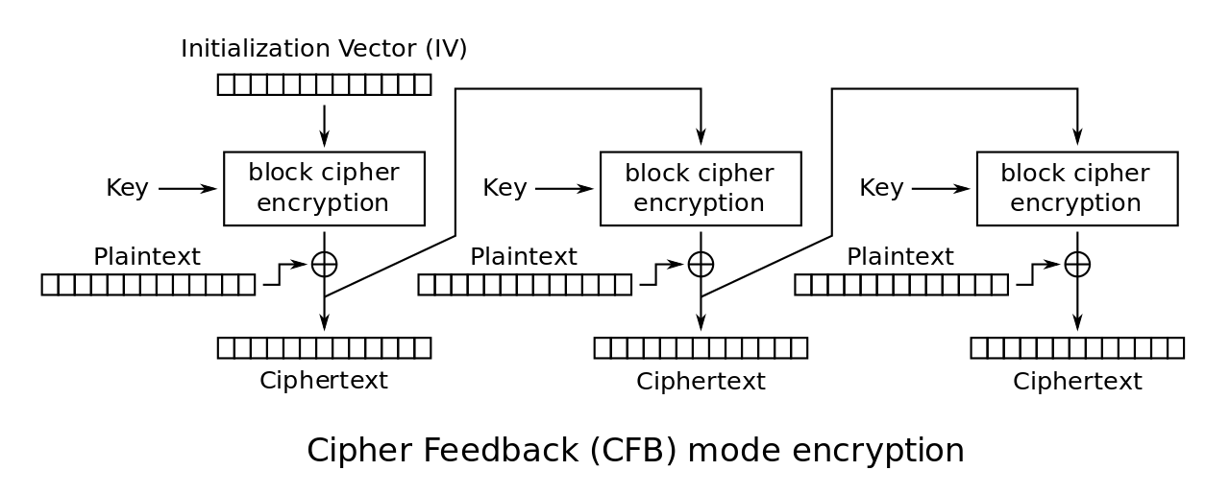
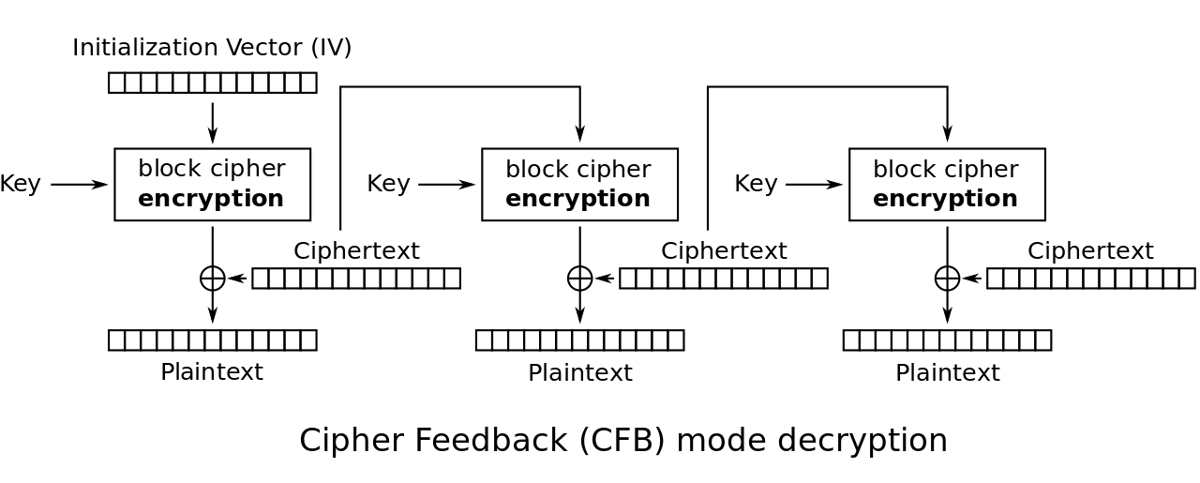
CFB Mode
Also IND-CPA
Try to analyze the trade-offs yourself:
Do we need to pad messages?
How robust is the scheme if we use it incorrectly?
Can we parallelize encryption/decryption?

Slide 69
CFB Mode
Try to analyze the trade-offs yourself:
Do we need to pad messages?
No
How robust is the scheme if we use it incorrectly?
Similar effects as CBC mode, but a bit worse if you reuse the IV
Can we parallelize encryption/decryption?
Only decryption is parallelizable

Slide 70
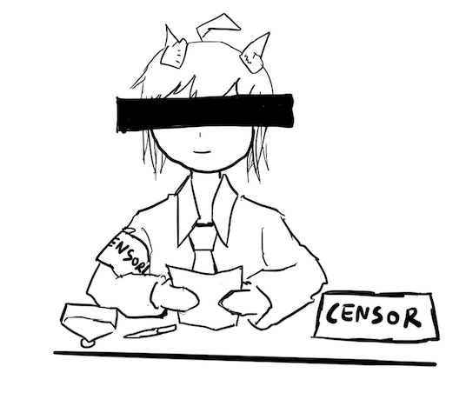
Lack of Integrity and Authenticity
Block ciphers are designed for confidentiality (IND-CPA)
If an attacker tampers with the ciphertext, we are not guaranteed to detect it
Remember Mallory: An active manipulator who wants to tamper with the message

Slide 71
Lack of Integrity and Authenticity
Consider CTR mode
What if Mallory tampers with the ciphertext using XOR?
P | a | y |  | M | a | l |  | $ | 1 | 0 | 0
0x50 | 0x61 | 0x79 | 0x20 | 0x4d | 0x61 | 0x6c | 0x20 | 0x24 | 0x31 | 0x30 | 0x30
M
⊕
EK(i)
0x8a | 0xe3 | 0x5e | 0xcf | 0x3b | 0x40 | 0x46 | 0x57 | 0xb8 | 0x69 | 0xd2 | 0x96
=
C
0xda | 0x82 | 0x27 | 0xef | 0x76 | 0x21 | 0x2a | 0x77 | 0x9c | 0x58 | 0xe2 | 0xa6

Slide 72
Lack of Integrity and Authenticity
Suppose Mallory knows the message M
How can Mallory change the M to say Pay Mal $900?
P | a | y |  | M | a | l |  | $ | 1 | 0 | 0
0x50 | 0x61 | 0x79 | 0x20 | 0x4d | 0x61 | 0x6c | 0x20 | 0x24 | 0x31 | 0x30 | 0x30
M
⊕
EK(i)
0x8a | 0xe3 | 0x5e | 0xcf | 0x3b | 0x40 | 0x46 | 0x57 | 0xb8 | 0x69 | 0xd2 | 0x96
=
C
0xda | 0x82 | 0x27 | 0xef | 0x76 | 0x21 | 0x2a | 0x77 | 0x9c | 0x58 | 0xe2 | 0xa6

Slide 73
Lack of Integrity and Authenticity
Ci | = | Mi ⊕ Padi | 0x58 | = | 0x31 ⊕ Padi | Definition of CTR
Padi | = | Mi ⊕ Ci | Padi | = | 0x58 ⊕ 0x31 | Solve for the ith byte of the pad
 |  |  |  | = | 0x69
C'i | = | M'i ⊕ Padi | C'i | = | 0x39 ⊕ 0x69 | Compute the changed ith byte
 |  |  |  | = | 0x50
C
0xda | 0x82 | 0x27 | 0xef | 0x76 | 0x21 | 0x2a | 0x77 | 0x9c | 0x58 | 0xe2 | 0xa6
C’
0xda | 0x82 | 0x27 | 0xef | 0x76 | 0x21 | 0x2a | 0x77 | 0x9c | 0x50 | 0xe2 | 0xa6

Slide 74
Lack of Integrity and Authenticity
What happens when we decrypt C'?
The message looks like “Pay Mal $900” now!
Note: Mallory didn’t have to know the key; no integrity or authenticity for CTR mode!
C'
0xda | 0x82 | 0x27 | 0xef | 0x76 | 0x21 | 0x2a | 0x77 | 0x9c | 0x50 | 0xe2 | 0xa6
⊕
EK(i)
0x8a | 0xe3 | 0x5e | 0xcf | 0x3b | 0x40 | 0x46 | 0x57 | 0xb8 | 0x69 | 0xd2 | 0x96
=
P'
0x50 | 0x61 | 0x79 | 0x20 | 0x4d | 0x61 | 0x6c | 0x20 | 0x24 | 0x39 | 0x30 | 0x30
P | a | y |  | M | a | l |  | $ | 9 | 0 | 0

Slide 75
Lack of Integrity and Authenticity
What about CBC?
Altering a bit of the ciphertext causes some blocks to become random gibberish
However, Bob cannot prove that Alice did not send random gibberish, so it still does not provide integrity or authenticity

Slide 76
Block Cipher Modes of Operation: Summary
ECB mode: Deterministic, so not IND-CPA secure
CBC mode
IND-CPA secure, assuming no IV reuse
Encryption is not parallelizable
Decryption is parallelizable
Must pad plaintext to a multiple of the block size
IV reuse leads to leaking the existence of identical blocks at the start of the message
CTR mode
IND-CPA secure, assuming no IV reuse
Encryption and decryption are parallelizable
Plaintext does not need to be padded
Nonce reuse leads to losing all security
Lack of integrity and authenticity

